Slide 1
Formal Specification Languages
Formal Specification Languages?
Formal specification languages are precise, mathematical languages used to describe the behavior, structure, and properties of software systems.
They provide a rigorous means of expressing system requirements, designs, and behavior.
Formal Specification Languages
Model-based Specification Languages: These languages describe the system behavior through models, such as state machines, Petri nets, or UML diagrams.
Algebraic Specification Languages: These languages describe systems using algebraic equations or operations, focusing on data types, operations, and their properties.
Logic-based Specification Languages: These languages describe systems using logical formulas, predicates, and rules, often based on mathematical logic such as first-order logic or temporal logic.

Slide 2
Formal Specification Languages
Examples of Formal Specification Languages:
Z: Z is a notation based on set theory and first-order logic. It is widely used for specifying the requirements and design of software systems.
VDM (Vienna Development Method): VDM is a formal method based on mathematical logic for specifying and modeling systems. It includes languages like VDM-SL (Specification Language) and VDM++.
B Method: The B Method uses formal specification languages like B and Event-B to describe and model systems, focusing on refinement and proof-based development.
TLA+ (Temporal Logic of Actions): TLA+ is a formal specification language for describing concurrent and distributed systems, based on temporal logic. It's known for its expressiveness in specifying complex systems and verifying properties.

Slide 3
Formal Specification Languages
Benefits of Formal Specification Languages:
Precision: Formal languages provide precise and unambiguous specifications, reducing ambiguity and improving understanding.
Verification: Formal specifications enable rigorous analysis and verification of system properties, such as correctness, safety, and liveness.
Early Detection of Errors: By formalizing requirements and designs, errors can be detected early in the development process, reducing the cost of fixing defects later.
Documentation: Formal specifications serve as detailed documentation that can be used for communication among stakeholders and as a basis for implementation.

Slide 4
Formal Specification Languages
Challenges and Considerations:
Complexity: Formal specification languages can be complex and require expertise to use effectively.
Tool Support: Availability of tools for formal analysis and verification varies across languages, which can impact adoption.
Learning Curve: Learning and mastering formal specification languages and associated tools require time and effort.
Maintainability: Formal specifications need to be maintained alongside the evolving software system, requiring synchronization between the specification and implementation.

Slide 5
Formal Specification Languages
1) Alloy:
Overview:
Alloy is a declarative specification language used primarily for modeling and analyzing software systems.
It focuses on describing structural properties and constraints using a first-order relational logic.
Features:
Alloy provides constructs for defining data structures, relations, and constraints.
It supports the specification of static and dynamic properties of systems.
Analysis:
Alloy specifications can be analyzed using the Alloy Analyzer tool, which employs constraint solving techniques to check the consistency of models, find counterexamples, and verify properties.
Application:
Alloy is commonly used for modeling and analyzing the behavior of software systems, particularly in the early stages of design to explore design alternatives and detect potential issues.

Slide 6
Formal Specification Languages
2) Object Constraint Language (OCL):
Overview:
OCL is a formal specification language used in conjunction with UML (Unified Modeling Language) to specify constraints and operations on objects in software systems.
Features:
OCL provides a rich set of expressions for defining constraints on UML models, including object invariants, pre- and post-conditions for operations, and navigational expressions for traversing object relationships.
Integration:
OCL is integrated with UML modeling tools and is used to refine and formalize the behavior and constraints of UML models.
Application:
OCL is widely used in software engineering for specifying and validating the behavior of object-oriented systems, ensuring consistency and correctness of UML models.

Slide 7
Formal Specification Languages
3) Java Modeling Language (JML):
Overview:
JML is a behavioral interface specification language for Java programs.
It allows developers to specify preconditions, postconditions, and class invariants using annotations within Java code.
Features:
JML annotations are written directly in Java code and provide a means of specifying behavioral contracts for methods and classes.
These contracts can be checked statically or dynamically using tools like JML compiler or runtime assertion checking.
Verification:
JML supports static verification of code properties using tools like ESC/Java and JMLrac (Runtime Assertion Checker), enabling developers to detect and eliminate defects early in the development process.
Application:
JML is used in Java development to improve code quality, enhance documentation, and facilitate formal verification of Java programs, particularly in safety-critical and mission-critical applications.

Slide 8
Formal Specification Languages
4) Z
Overview:
Z is a formal specification language based on set theory and first-order logic.
It provides a notation for describing the structure and behavior of software systems in a precise and mathematical manner.
Z specifications consist of mathematical schemas that define the state space, operations, and constraints of a system.
Features:
Mathematical Rigor: Z specifications are based on rigorous mathematical concepts, providing a clear and unambiguous representation of system requirements and design.
Modularity: Z allows for the decomposition of specifications into smaller, reusable components called schemas, promoting modularity and maintainability.
Specification Constructs: Z provides constructs for defining sets, functions, relations, and operations, as well as logical connectives and quantifiers for expressing constraints and properties.
Abstraction: Z supports abstraction mechanisms, enabling the separation of concerns and the specification of system behavior at different levels of detail.

Slide 9
Formal Specification Languages
4) Z
Analysis:
Formal Verification: Z specifications can be subjected to formal analysis techniques, such as model checking and theorem proving, to verify properties like correctness, consistency, and completeness.
Refinement: Z supports the notion of refinement, allowing for the stepwise development of systems from abstract specifications to concrete implementations while preserving correctness.
Application:
Requirements Engineering: Z is used in requirements engineering to formalize and validate system requirements, ensuring a clear and precise understanding between stakeholders.
Software Design: Z facilitates the formal specification and design of software systems, aiding in the development of correct and reliable software by capturing system structure, behavior, and constraints.
Critical Systems: Z is commonly applied in safety-critical and mission-critical systems, such as aerospace, automotive, and healthcare, where correctness and reliability are paramount.
Education and Research: Z is used in academia and research for teaching formal methods and conducting studies on formal specification techniques, tools, and methodologies.

Slide 10
Formal Specification Languages
5) VDM (Vienna Development Method):
Overview:
VDM is a formal method for software engineering, originating from the work of the Formal Methods Group at the Technical University of Vienna.
It provides a framework for specifying, modeling, and validating software systems using mathematical logic.
Features:
Formal Specification Languages: VDM includes languages like VDM-SL (Specification Language) and VDM++ for specifying system requirements, designs, and behavior using mathematical constructs.
Mathematical Rigor: VDM specifications are based on rigorous mathematical principles, including set theory, functions, and types, ensuring clarity and precision in system descriptions.
Support for Data and Functionality: VDM allows for the specification of both data structures and operations, enabling the description of system behavior and functionality.
Tool Support: VDM is supported by various tools, such as VDMTools, Overture, and VDMJ, which provide environments for editing, analyzing, and executing VDM specifications.

Slide 11
Formal Specification Languages
5) VDM (Vienna Development Method):
Analysis:
Model Checking: VDM specifications can be subjected to model checking techniques to verify properties such as consistency, correctness, and completeness.
Simulation and Animation: VDM tools support simulation and animation features, allowing developers to interactively explore and validate system behavior specified in VDM.
Proof and Verification: VDM supports formal verification techniques, including theorem proving and proof obligations, to ensure the correctness and reliability of system specifications.
Application:
Software Development: VDM is used in software development for specifying and modeling system requirements and designs, particularly in safety-critical and mission-critical domains.
Formal Verification: VDM is applied in formal verification projects to rigorously validate system properties, detect defects, and ensure compliance with requirements.
Education and Training: VDM is used in academia and industry for teaching formal methods, software engineering, and modeling techniques, providing students and practitioners with a solid foundation in formal specification and analysis.

Slide 12
Formal Specification Languages
Z Language
Overview
Z is a formal specification language that provides a mathematical notation for describing the structure, behavior, and properties of software systems.
It was developed in the late 1970s and early 1980s by Jean-Raymond Abrial at the Oxford University Computing Laboratory.
Z is based on set theory and first-order logic and is widely used in software engineering for specifying system requirements and designs.

Slide 13
Formal Specification Languages
Z Language
Key Concepts:
Schema:
The primary construct in Z is the schema, which is used to define sets, functions, and relations, as well as their properties and constraints.
A schema consists of a header and a body, where the header declares the variables and parameters, and the body specifies the constraints and properties.
Sets and Types:
Z provides a rich set of constructs for defining sets and types.
Sets can be explicitly enumerated, defined by comprehension, or specified as subsets of other sets.
Types can be defined as sets of values that satisfy certain properties.
Operations:
Z allows for the specification of operations on sets, functions, and relations. Operations can be described using schemas, which define preconditions, postconditions, and properties of the operation.

Slide 14
Formal Specification Languages
Z Language
Key Concepts:
Predicates and Assertions:
Predicates are used in Z to express logical conditions and constraints.
Assertions are predicates that must hold true at certain points in the system's execution, typically at the beginning or end of operations.
Refinement:
Z supports the notion of refinement, which allows for the stepwise development of system specifications from abstract, high-level descriptions to concrete, detailed implementations.
Refinement involves adding detail to specifications while preserving correctness and consistency.
Proof and Verification:
Z specifications can be subjected to formal analysis techniques, such as theorem proving and model checking, to verify properties like consistency, correctness, and completeness.
Formal proofs are used to demonstrate that a specification satisfies its properties and requirements.

Slide 15
Formal Specification Languages
Z Language
Terminology and Concepts:
1) Data
Refers to necessary data use in the system
2) Schema
Refers to a structure that has two (2) sections the signature and predicates.
The signature (top section) contents all the set proposition thus the data, and variables.
The predicate (bottom section) shows the relationship between the variables.
The relationship must be true in every state of the system and is maintained by every operation on it:
3) Functions
Functions are a special case of relations in which each element in one set (domain - dom) has one more value associated with another set (range - ran).
They are represented by arrows.
4) Variable
Variable name here refers a pre-condition or current condition.
Meaning the variable is in a state before any changes is made to it
5) Variable’
Variable’ name here refers a post-condition.
Meaning the variable is in a state after changes is made to it
6) Variable?
The value for this variable comes from an input device. (input)
7) Variable!
The value for this variable will be shown or listed out (output)

Slide 16
Formal Specification Languages
Z Language
Functions and relation in Z
Functions:
Total Function (→):
A total function maps every element from its domain to exactly one element in its range.
Notation: f: A → B where f is the function, A is the domain, and B is the range.
Example: f: ℕ → ℤ represents a function from natural numbers to integers.
Partial Function (↔):
A partial function maps some elements from its domain to elements in its range, but not necessarily all.
Notation: f: A ⇸ B where f is the function, A is the domain, and B is the range.
Example: f: ℤ ⇸ ℕ represents a partial function from integers to natural numbers.

Slide 17
Formal Specification Languages
Z Language
Functions and relation in Z
Partial Injection (Partial Injective Function):
A partial injection, also known as a partial injective function, maps elements from its domain to elements in its range without allowing multiple elements from the domain to map to the same element in the range.
Notation: f: A ⇸ B, where f is the function, A is the domain, and B is the range.
Example: If f: ℕ ⇸ ℤ, it means that f is a partial injection from natural numbers to integers, allowing some natural numbers to map to distinct integers but not necessarily all natural numbers.

Slide 18
Formal Specification Languages
Z Language
Functions and relation in Z
Total Injection (Total Injective Function):
A total injection, also known as a total injective function, is similar to a partial injection but requires that every element in the domain maps to a unique element in the range.
Notation: f: A ⇺ B, where f is the function, A is the domain, and B is the range.
Example: If f: ℕ ⇺ ℤ, it means that f is a total injection from natural numbers to integers, ensuring that every natural number maps to a distinct integer.

Slide 19
Formal Specification Languages
Z Language
Functions and relation in Z
Surjection (Surjective Function):
A surjection, also known as a surjective function, is a function in which every element in the range is mapped to by at least one element in the domain.
Notation: f: A ↠ B, where f is the function, A is the domain, and B is the range.
Example: If f: ℕ ↠ ℤ, it means that f is a surjection from natural numbers to integers, ensuring that every integer is mapped to by at least one natural number.

Slide 20
Formal Specification Languages
Z Language
Example
Here's a simple example of a Z schema that specifies a basic data structure:
schema Stack
max_size: ℕ // Maximum size of the stack
elements: ℤ* // Sequence of integer elements
// Preconditions: stack is not full
// Postconditions: element is added to the top of the stack
push(elem: ℤ)
// Preconditions: stack is not empty
// Postconditions: element is removed from the top of the stack
pop()
// Invariant: number of elements does not exceed max_size
inv size(elements) ≤ max_size
end Stack

Slide 21
Z notation Examples
Define a Z schema for a bank account with the following attributes and operations:
Attribute: balance (integer) representing the current balance of the account.
Operations: deposit(amount) to deposit money into the account and withdraw(amount) to withdraw money from the account.
Write the invariant for the bank account schema to ensure that the balance is always non-negative.
schema BankAccount
balance: ℤ // Current balance of the account
// Operation to deposit money into the account
deposit(amount: ℤ)
// Operation to withdraw money from the account
withdraw(amount: ℤ)
// Invariant: balance is always non-negative
inv balance ≥ 0
end BankAccount

Slide 22
Z notation Examples
Create a Z schema for a stack data structure with the following characteristics:
Attribute: elements representing a sequence of integer elements.
Operations: push(elem) to add an element onto the stack and pop() to remove an element from the stack.
Define an invariant for the stack schema to ensure that the stack is never empty.
schema Stack
elements: ℤ* // Sequence of integer elements
// Operation to push an element onto the stack
push(elem: ℤ)
// Operation to pop an element from the stack
pop()
// Invariant: stack is never empty
inv ¬isEmpty(elements)
// Function to check if the stack is empty
isEmpty(s: ℤ*) == s = <>
end Stack

Slide 23
Z notation Examples
Develop a Z schema for a shopping cart with the following attributes and operations:
Attribute: items representing a set of products in the cart.
Operations: addProduct(product) to add a product to the cart and removeProduct(product) to remove a product from the cart.
Write an invariant for the shopping cart schema to ensure that the cart cannot contain duplicate items.
schema ShoppingCart
items: ℙ(Products) // Set of products in the cart
// Operation to add a product to the cart
addProduct(product: Products)
// Operation to remove a product from the cart
removeProduct(product: Products)
// Invariant: cart cannot contain duplicate items
inv items = items ∩ (items \ {product})
end ShoppingCart

Slide 24
Z notation Examples
Define a Z schema for a queue data structure with the following characteristics:
Attribute: elements representing a sequence of integer elements.
Operations: enqueue(elem) to add an element to the rear of the queue and dequeue() to remove an element from the front of the queue.
Write the invariant for the queue schema to ensure that the queue is never empty.
schema Queue
elements: ℤ* // Sequence of integer elements
// Operation to enqueue an element into the queue
enqueue(elem: ℤ)
// Operation to dequeue an element from the queue
dequeue()
// Invariant: queue is never empty
inv ¬isEmpty(elements)
// Function to check if the queue is empty
isEmpty(q: ℤ*) == q = <>
end Queue

Slide 25
Z notation Examples
Develop a Z schema for a binary tree data structure with the following attributes and operations:
Attribute: root representing the root node of the binary tree.
Operations: insert(value) to insert a value into the binary tree and search(value) to search for a value in the binary tree.
Define a node schema within the binary tree schema to represent individual nodes with a value, left child reference, and right child reference.
schema BinaryTree
root: Node // Root node of the binary tree
// Operation to insert a value into the binary tree
insert(value: ℤ)
// Operation to search for a value in the binary tree
search(value: ℤ) : BOOL
// Node definition with left and right child references
Node ::= value: ℤ
left: Node ∪ {nil}
right: Node ∪ {nil}
end BinaryTree

Slide 26
Z notation Examples
Create a Z schema for a matrix data structure with the following attributes and operations:
Attributes: rows representing the number of rows, cols representing the number of columns, and elements representing the matrix elements.
Operations: getElement(row, col) to retrieve an element from the matrix and setElement(row, col, value) to set an element in the matrix.
Write the invariant for the matrix schema to ensure that the number of rows and columns is always positive integers. schema Matrix
rows: ℤ // Number of rows in the matrix
cols: ℤ // Number of columns in the matrix
elements: ℤ[1..rows][1..cols] // Matrix elements
// Operation to retrieve an element from the matrix
getElement(row: ℤ, col: ℤ): ℤ
// Operation to set an element in the matrix
setElement(row: ℤ, col: ℤ, value: ℤ)
// Invariant: rows and columns are positive integers
inv rows > 0 ∧ cols > 0
end Matrix

Slide 27
Assignment-CLO# Q#01 (Z notation)
Define a Z schema for the Birth Book with the following characteristics:
Attributes: individuals representing a set of person names and birthDates representing a mapping from person names to their birth dates.
Operations: addIndividual(name, date) to add a new individual and their birth date to the birth book, getBirthDate(name) to retrieve the birth date of an individual, and individualExists(name) to check if an individual exists in the birth book.
b) Write the invariant for the Birth Book schema to ensure that each individual has a unique birth date.
c) Describe the addIndividual operation in the Birth Book schema and provide an example of its usage.
d) Explain how you would use the getBirthDate operation to retrieve the birth date of a specific individual from the Birth Book schema.
e) Discuss the significance of the invariant in the Birth Book schema and its role in maintaining the integrity of the birth book data.
f) Consider a scenario where you need to add a new individual to the Birth Book. Describe the steps you would take to ensure that the operation maintains the integrity of the birth book data.

Slide 28
Assignment-CLO# Q#02 (JML)
Define a Java class called Student representing students in a school. The class should have the following attributes and operations:
Attributes:
name: A string representing the name of the student.
age: An integer representing the age of the student.
grade: An integer representing the grade level of the student.
Operations:
setName(name: String): A method to set the name of the student.
setAge(age: int): A method to set the age of the student.
setGrade(grade: int): A method to set the grade level of the student.
getName(): String: A method to retrieve the name of the student.
getAge(): int: A method to retrieve the age of the student.
getGrade(): int: A method to retrieve the grade level of the student.
Apply JML annotations to specify the preconditions, postconditions, and class invariants for the Student class.

Slide 29
Assignment-CLO# Q#03 (OCL)
Define an OCL specification for a class called Book representing books in a library. The class should have the following attributes and operations:
Attributes:
title: A string representing the title of the book.
author: A string representing the author of the book.
year: An integer representing the publication year of the book.
Operations:
setTitle(title: String): A method to set the title of the book.
setAuthor(author: String): A method to set the author of the book.
setYear(year: Integer): A method to set the publication year of the book.
getTitle(): String: A method to retrieve the title of the book.
getAuthor(): String: A method to retrieve the author of the book.
getYear(): Integer: A method to retrieve the publication year of the book.
Apply OCL expressions to specify the preconditions, postconditions, and invariants for the Book class.

Slide 30
Assignment-CLO# Q#04, 05
Q#04: Compare and contrast OCL, JML, Alloy, and Z in terms of their features, application domains, and expressiveness. Provide examples to illustrate their use cases and highlight the strengths and weaknesses of each formal specification languages.
Q#05: Explain the process of formal verification in software engineering and discuss its importance in ensuring the correctness and reliability of software systems. Provide examples of formal verification techniques and explain how they are applied in practice.

Slide 31

JAVA MODELING Language

Slide 32
Java Modeling Language - Introduction
Formal specification language for Java
to specify behavior of Java classes
to record design & implementation decisions by adding assertions to Java source code, e.g.
preconditions
postconditions
invariants
JML is designed for unit specification.
Goal: JML should be easy to use for any Java programmer.

Slide 33
Unit Specification
Through JML we specify requirements for individual units rather than for the entire system altogether
A unit is the smallest testable part of any software. It usually has one or a few inputs and usually a single output.
In Java, those units are:
methods, where JML specifies the effect of a single method invocation;
classes, where JML merely specifies constraints on the internal structure of an object; and
interfaces, where JML specifies the external behavior of an object.

Slide 34
JML Contd.
To make JML easy to use:
JML specifications are added as comments in .java file,
between /* @ . . . @*/
or after //@
Properties are specified as Java boolean expressions, extended with a few operators (\old, \forall, \result, . . .).
using a few keywords (requires, ensures, signals, assignable, pure, invariant, non null, . . . )

Slide 35
Pre and Post Conditions
Pre- and post-conditions for method can be specified.
/*@ requires amount >= 0;
ensures balance == \old(balance)-amount &&
\result == balance; @*/
public int debit(int amount) {
...
}
Here \old(balance) refers to the value of balance before execution of the method.

Slide 36
Design by Contract Paradigm
Pre- and postconditions define a contract between a class and its clients:
Client must ensure precondition and may assume postcondition
Method may assume precondition and must ensure postcondition
Eg, in the example specs for debit, it is the obligation of the client to ensure that amount is positive.
The requires clause makes this explicit.

Slide 37
Exceptional Post Conditions
Exceptional postconditions can also be specified.
final String AMOUNT_TOO_BIG = “amount > balance ”
int balance;
/* @ requires amount >= 0;
ensures balance == \old(balance)-amount &&
\result == balance;
signals (IOException e) amount > balance &&
balance == \old(balance) &&
e.getReason()==AMOUNT_TOO_BIG; @*/
public int debit(int amount) { ... }

Slide 38
Exceptional Post Conditions
Exceptions are allowed by default, i.e. the default signals clause is
signals (Exception) true;
To rule them out,
Add an explicit signals (Exception) false;
Or use the keyword normal_behavior
/*@ normal_behavior
requires ...
ensures ... @*/

Slide 39
Invariants
Invariants (aka class invariants) are properties that must be maintained by all methods, e.g.,
public class Wallet {
public static final short MAX_BAL = 10000;
private short balance;
/*@ invariant 0 <= balance && balance <= MAX_BAL; @*/
… }
Invariants are implicitly included in all pre- and postconditions.
Invariants must also be preserved if exception is thrown!
They can however be violated during method execution

Slide 40
Invariants
Invariants document design decisions, e.g.,
public class Directory {
private File[] files ;
/*@ invariant files != null &&
(\forall int i; 0 <= i && i < files.length; ;
files[i] != null && files[i].getParent() == this); @*/
Making them explicit helps in understanding the code.

Slide 41
JML Keywords

Slide 42
Contents
non_null
nullable
assignable
Pure
Visibility Keyword – spec_public

Slide 43
non_null
Many invariants, pre- and postconditions are about references not being null.
non_null is a convenient short-hand for these.
public class Directory {
private /*@ non_null @*/ File[] files;
void createSubdir(/*@ non_null @*/ String name){ … }
Directory /*@ non_null @*/ getParent() { ... }
}

Slide 44
Contd.
non_null is default.
Previous example can be written as follows and will imply the same specification.
public class Directory {
private File[] files;
void createSubdir(String name){ … }
Directory getParent() { ... }
}

Slide 45
nullable
To prevent variables to be non_null by default nullable keyword is used.
public class Directory {
private /*@ nullable @*/ File[] files;
void createSubdir(/*@ nullable @*/ String name){ … }
Directory /*@ nullable @*/ getParent() { ... }
}

Slide 46
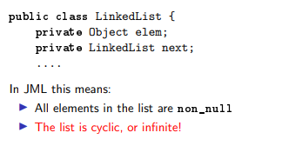
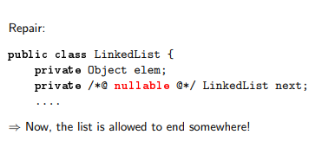

Slide 47
assert
An assert clause specifies a property that should hold at some point in the code, e.g.,
if (i <= 0 || j < 0) { ... }
else if (j < 5) {
//@ assert i > 0 && 0 < j && j < 5;
... }
else {
//@ assert i > 0 && j > 5;
... }

Slide 48
assignable
Frame properties limit possible side-effects of methods.
/*@ requires amount >= 0;
assignable balance;
ensures balance == \old(balance)-amount; @*/
public int debit(int amount) { ...
debit can only assign to the field balance.
Default assignable clause: assignable \everything.

Slide 49
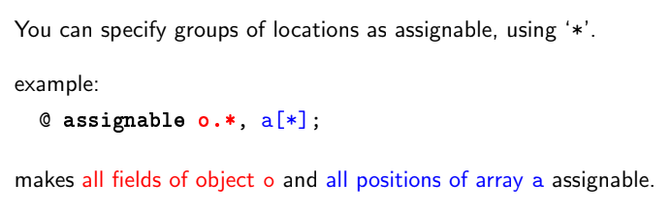

Slide 50
pure
A method without side-effects is called pure.
public /*@ pure @*/ int getBalance(){...
Directory /*@ pure non_null @*/ getParent(){...
Pure method are implicitly assignable \nothing.
Only pure methods can be used in specifications.

Slide 51
Visibility
JML supports the standard Java visibilities:
Specs of public methods can not refer to private fields.
public int pub;
private int priv;
//@ requires i <= pub;
public void pub1 (int i) { ... }
//@ requires i <= pub && i <= priv;
private void priv1 (int i) ...
//@ requires i <= pub && i <= priv; //WRONG !!
public void pub2(int i) { ... }

Slide 52
spec_public
Keyword spec_public loosens visibility for specs.
Private spec_public fields are allowed in public specs, e.g.:
public int pub ;
private /*@ spec_public @*/ int priv;
//@ requires i <= pub && i <= priv; //OK
public void pub2(int i) { ... }

Slide 53
Thank you!

Slide 54
Java Modeling Language

Slide 55
Agenda
JML Expressions
FOL in JML
JML Quantifiers
Examples
JML & Inheritance

Slide 56
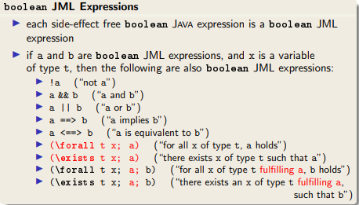
JML Expressions

Slide 57
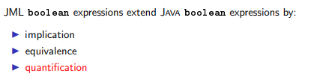
FOL in JML

Slide 58
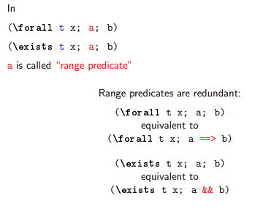
JML Quantifiers

Slide 59


Using Quantified JML expressions

Slide 60
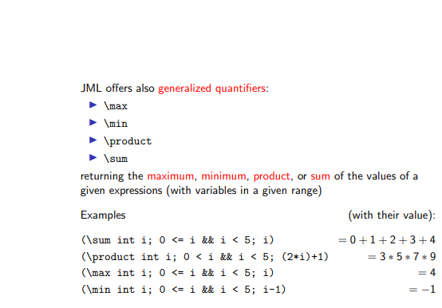
Generalized Quantifiers

Slide 61
Inheritance & JML

Slide 62
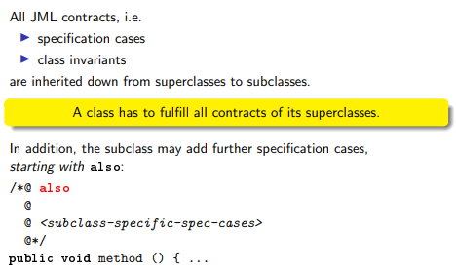
JML & Inheritance

Slide 63
Example 1

Slide 64
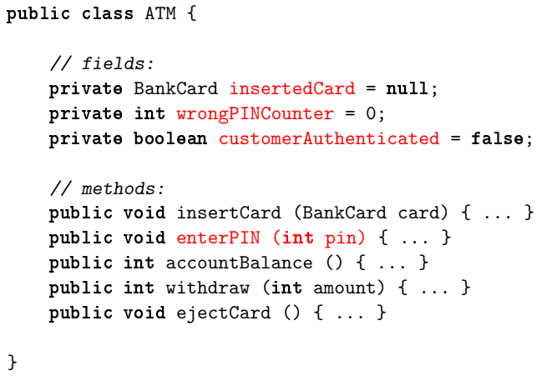
class BankCard {
protected Account account;
protected boolean invalid;
protected int correctPin;
}

Slide 65
Informal Specification
Very informal Specification of ‘enterPIN (int pin)’:
Checks whether the pin belongs to the bank card currently inserted in the ATM. If a wrong pin is received three times in a row, the card is confiscated. After receiving the correct pin, the customer is regarded as authenticated.

Slide 66
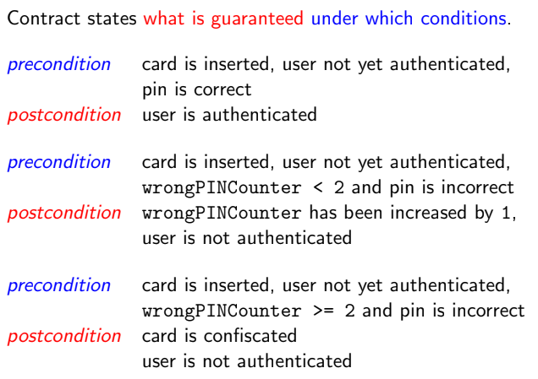
Getting more precise Specification as Contracts

Slide 67
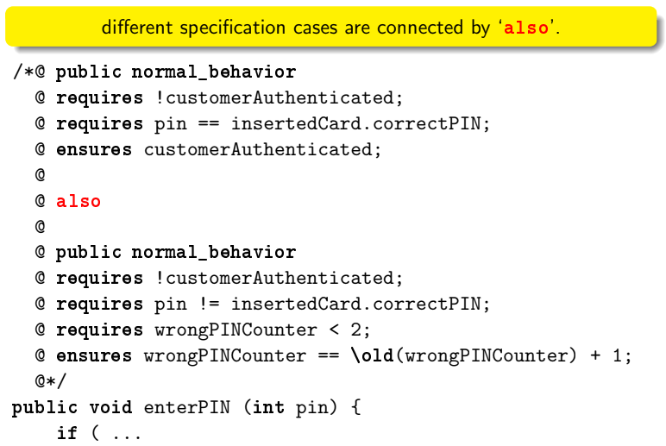
JML by Example

Slide 68
Getting more precise Specification as Contracts

Slide 69
JML by Example

Slide 70
Getting more precise Specification as Contracts

Slide 71
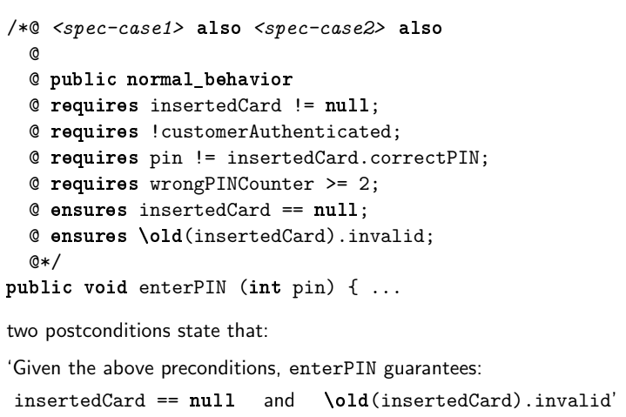
Contd.

Slide 72
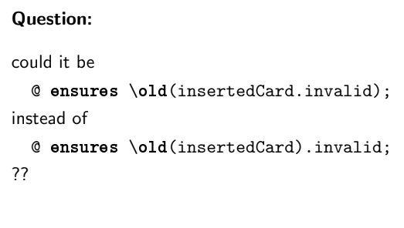
Contd.

Slide 73
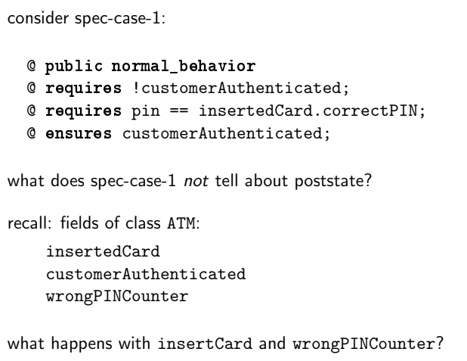
Are specification cases complete?

Slide 74
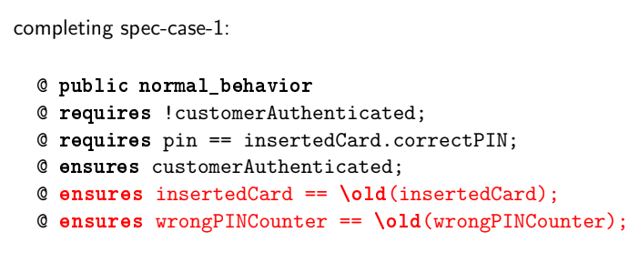
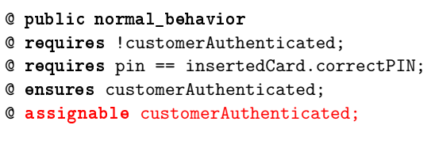
Completing spec-case-1
OR

Slide 75
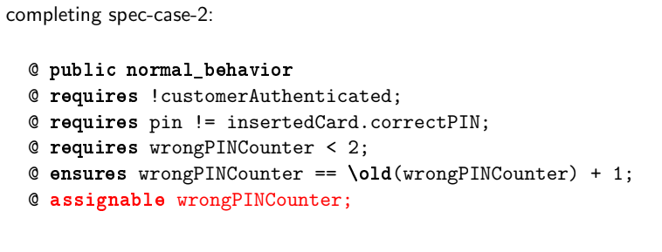
Completing spec-case-2

Slide 76
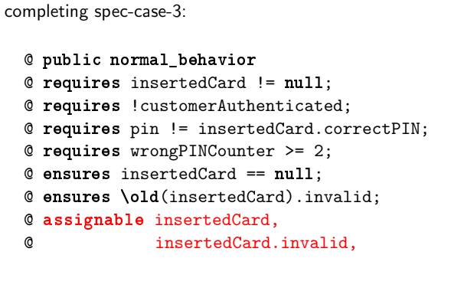
Completing spec-case-3

Slide 77
Deductive Verification
Using various tools, you can verify program specifications written in JML.
These tools specifically the KeY tool provide a theorem prover for Java, Modeling Language & Java Dynamic Logic based on a sequent calculus.
It allows for full functional verification of sequential Java

Slide 78
Formal Verification with KeY
JML annotations, Java programs, and the rules of symbolic execution are all translated automatically to formulas and rules of the program logic that is used by KeY.
It is not necessary to understand the details of this. Suffice it to say, when loading a class, annotated with JML contracts, into KeY, a proof obligation formula is generated and loaded into its theorem prover.
Then the user selects a method and its contract and attempts to show its validity.
If the theorem prover can show the validity of the proof obligation formula relating to a given contract and method, then we know the following is true:
If the method is started in any Java state that satisfies the requires clause, then upon termination, the final state satisfies the ensures clause.
KeY’s theorem prover provides a high degree of automation but allows also interactions by the user in case a proof cannot be found automatically.
Most often, interactions with the prover consist in providing additional annotations such as invariants.
If no proof is found, then the failed proof needs to be analysed as to whether the specification is too weak or wrong, the program is buggy or the automation is not powerful enough and further interaction by the user is required.

Slide 79
Additional References
KeY Verification Tool Tutorial Link
https://www.key-project.org/applications/program-verification/#Tutorials

Slide 80
THANK YOU!

Slide 81
Object Constraint Language

Slide 82
Motivation
UML diagrams don’t tell everything
Q: What does the following class diagram tell?
House
0..*
owner
Person
houses
1
security
1
1
borrower
0..*
Mortgage
0..*
mortgages
mortgages

Slide 83
What is OCL?
Standard “add-on” to UML
OCL expressions are dependent on types from UML diagrams
Language for expressing additional information (e.g., constraints and business rules) about UML models
Characteristics
Constraint and query languages
Math foundation (set and predicate) but no math symbols
Strongly typed, declarative, and no side effect
High level of abstraction (platform independence)

Slide 84
Basics of OCL
Associating OCL expressions to UML models
Directly to diagrams as notes
Separate accompanying texts, e.g.,
context Person
inv: age >= 0
Person
-age
inv: age >= 0

Slide 85
Invariants
State conditions that must be always be met by all instances of context types (classes or interfaces)
Examples:
context Company inv:
self.numberOfEmployees > 50
context c: Company inv:
c.numberOfEmployees > 50
context c: Company inv enoughEmployees:
c.numberOfEmployees > 50
self: contextual instance, an instance to which the OCL expression is attached
an optional label
An explicit specification of contextual instance, c

Slide 86
Pre and post-conditions
Connditions that must be true at the moment when an operation begins and ends its execution.
Examples
context Account::deposit(amt: Integer): void
pre: amt > 0
post: balance = balance@pre + amt
context Account::deposit(amt: Integer): void
pre argumentOk: amt > 0
post balanceIncreased: balance = balance@pre + amt
pre-value
referring to previous value before the function was called
optional label

Slide 87
Contd.
Referring to pre and result values
@pre: denotes the value of a property at the start of an operations
result: denotes the result of an operation
Examples:
context Account::payInterest(rate: Real): void
post: balance = balance@pre + calcInterest@pre(rate)
context Account::getBalance(): Integer
post: result = balance

Slide 88
Navigating in OCL Expressions
Use dot notation to navigate through associations
Direction and multiplicity matter
Use role names or class names
0..*
owner
Account
accounts
1
Customer
context Account
inv: self.owner … -- evaluate to a single Customer
self.customer …
context Customer
inv: self.accounts->size() … -- evaluate to a collection
self.account … -- of accounts
Arrow notation for collection operations
single line (--) or multiple lines (/* … */)

Slide 89
Types in OCL
Two different kinds
Predefined types (as defined in standard library)
Basic types: Integer, Real, String, Boolean
Collection types: Set, OrderedSet, Bag, Sequence
User-defined types: classes, interfaces, and enumerations.

Slide 90
Pre-Defined: Basic Values
Several built-in types and operations
Type | Values | Operations
Boolean | false, true | or, and, xor, not, =, <>, implies
Integer | -10, 0, 10, … | =, <>, <, >, <=, >=, +, -, *, /, mod(), div(), abs(), max(), min(), round(), floor()
Real | -1.5, 3.14, …
String | ‘Carmen’ | =, <>, concat(), size(), toLower(), toUpper(), substring()

Slide 91
Pre-Defined: Collections
Why?
Multiple objects produced by navigating associations
If multiplicity > 1, collections based on properties
Set: {unique} (default)
OrderedSet: {unique, ordered}
Bag: {notUnique}
Sequence: {notUnique, ordered}
context Account
inv: self.owner.name <> ''
context Customer
inv: self.accounts->size() > 0
0..*
owner
Account
accounts
1
Customer

Slide 92
Examples
Set{10, 100}
OrderedSet{'apple', 'orange'}
Bag{10, 10, 100}
Sequence{10, 10, 100}, Sequence{1..10}, Sequence{1..(5 + 5)}
Set{Set{1}, Set{10}}

Slide 93
Collection Operation
Large number of predefined operations
Arrow notation, e.g., c->size()
0..*
owner
Account
accounts
1
Customer
context Account
inv: not owner->isEmpty()

Slide 94
Collection Operations
Operation | Description
count(o) | Number of occurrences of o in the collection (self)
excludes(o) | Is o not an element of the collection?
excludesAll(c) | Are all the elements of c not present in the collection?
includes(o) | Is o an element of the collection?
includesAll(c) | Are all the elements of c contained in the collection?
isEmpty() | Does the collection contain no element?
notEmpty() | Does the collection contain one or more elements?
size() | Number of elements in the collection
sum() | Addition of all elements in the collection

Slide 95
Iteration Operation
Loop over elements by taking one element at a time
Iterator variables
Optional variable declared and used within body
Indicate the element being iterated
Always of the element type, thus, type declaration is optional
context Customer
inv: self.accounts->forAll(a: Account | a.owner = self)
inv: accounts->forAll(a | a.owner = self)
inv: accounts->forAll(owner = self)

Slide 96
Iteration Operations
Operation | Description
any(expr) | Returns any element for which expr is true
collect(expr) | Returns a collection that results from evaluating expr for each element of self
exists(expr) | Has at least one element for which expr is true?
forAll(expr) | Is expr true for all elements?
isUnique(expr) | Does expr has unique value for all elements?
iterate(x: S; y: T| expr) | Iterates over all elements
one(expr) | Has only one element for which expr is true?
reject(expr) | Returns a collection containing all elements for which expr is false
select(expr) | Returns a collection containing all elements for which expr is true
sortedBy(expr) | Returns a collection containing all elements ordered by expr

Slide 97
Iteration Operations - Examples
accounts->any(a: Account | a.balance > 1000)
accounts->collect(name) -- all the names
accounts->exists(balance > 5000)
accounts->forAll(balance >= 0)
accounts->isUnique(name)
accounts->iterate(a: Account; sum: Integer = 0 | sum + a.balance)
accounts->one(name = ‘Carmen’)
accounts->reject(balance > 1000)
accounts->select(balance <= 1000)
accounts->sortedBy(balance)

Slide 98
Iteration Operations - Examples
accounts->any(a: Account | a.balance > 1000)
accounts->collect(name) -- all the names
accounts->exists(balance > 5000)
accounts->forAll(balance >= 0)
accounts->isUnique(name)
accounts->iterate(a: Account; sum: Integer = 0 | sum + a.balance)
accounts->one(name = ‘Carmen’)
accounts->reject(balance > 1000)
accounts->select(balance <= 1000)
accounts->sortedBy(balance)

Slide 99
The iterate Operation
Most fundamental and generic loop operation
All other loop operations are special cases
iterate(elem: T1; result: T2 = expr | expr-elem-result)
Example
Set{1, 2, 3}->sum()
Set{1, 2, 3}->iterate(i: Integer; r: Integer = 0 | r + i)

Slide 100
USE Tool

Slide 101
Contents
USE Tool
Specifying Models
Defining Models
Defining Classes
Defining Associations
Adding Constraints
Examples

Slide 102
USE Tool
A USE tool requires a textual description of a model using features found in UML class diagrams (classes, associations, etc.).
Expressions written in the Object Constraint Language (OCL) are used to specify additional integrity constraints on the model.

Slide 103
Specifying a UML Model
The USE tool expects a textual description of a model and its constraints as input.
The example must therefore be translated into a USE specification by using an external text editor.
The USE specification of the example model is shown in the next slide.

Slide 104
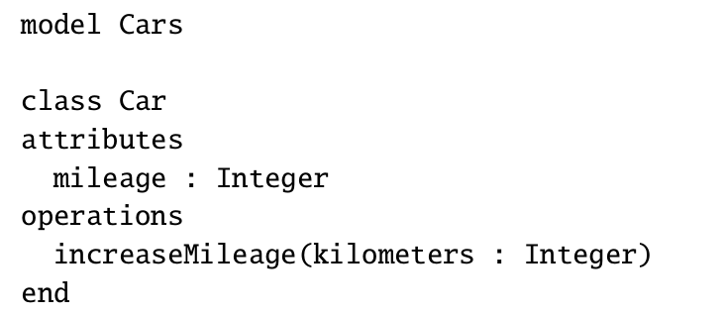
UML Model
USE Tool Specification
Car
-mileage: Integer
+increaseMileage(Kilometers: Integer):void

Slide 105
Defining a UML Model
Every UML Model has a name and an optional body.
The model body consists of at least one class definition and an arbitrary number of association definitions.
At the end of the specification OCL constraints may be defined.
Example:
model Employee

Slide 106
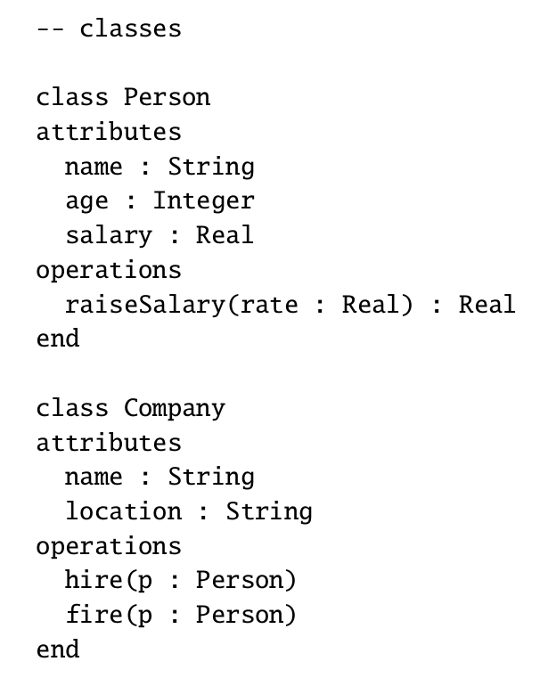
UML Model
Defining Classes
Person
-name:String
-age: Integer
-salary: Real
+raiseSalary(rate:Real):Real
Company
-name:String
-location:String
+hire(p:Person):void
+fire(p:Person):void

Slide 107
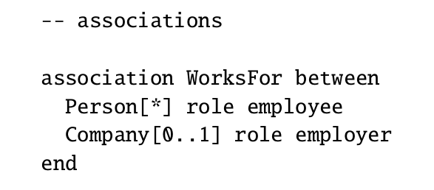
Defining Associations
Person
-name:String
-age: Integer
-salary: Real
+raiseSalary(rate:Real):Real
employee
*
Company
-name:String
-location:String
+hire(p:Person):void
+fire(p:Person):void
WorksFor
0..1
employer

Slide 108
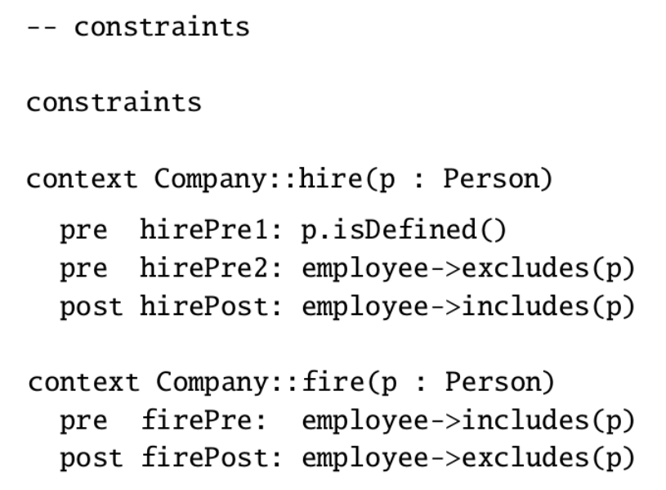
Adding Constraints
Adding Constraints
hire(p:person)
Pre-condition 1: Person p must be defined
Pre-condition 2: p should not already be an employee of the company.
Post-condition: p should become one of the employees of the company
fire(p:Person)
Pre-condition: P must be an employee of the company
Post-condition: P is no longer an employee of the company

Slide 109
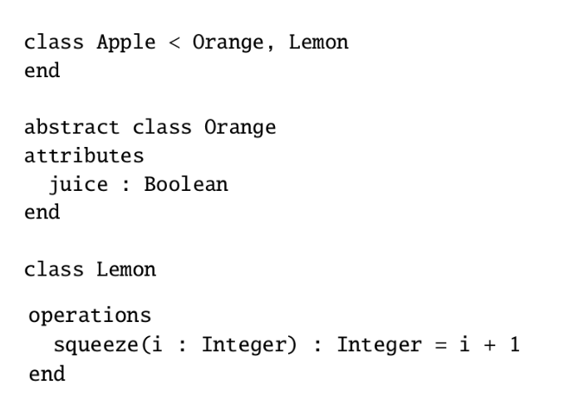
Inheritance in OCL
Orange
-juice:Boolean
Lemon
+squeeze(i: Integer):Integer
extends
extends
Apple

Slide 110
Example 2

Slide 111
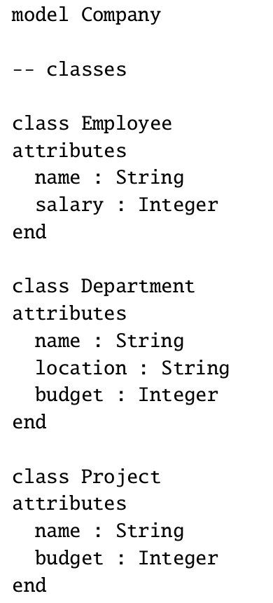
Defining Classes
Employee
-name:String
-salary: Integer
Project
-name:String
-budget: Integer
Department
-name:String
-location:String
-budget: Integer

Slide 112
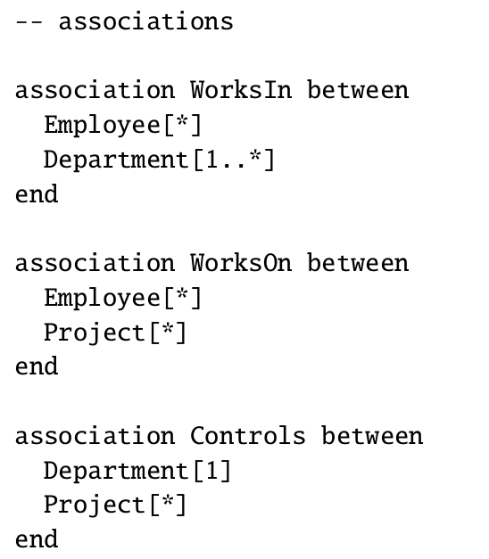
Defining Associations
Employee
-name:String
-salary: Integer
*
*
WorksOn
WorksIn
1..*
*
Project
-name:String
-budget: Integer
Department
-name:String
-location:String
-budget: Integer
*
1
Controls

Slide 113
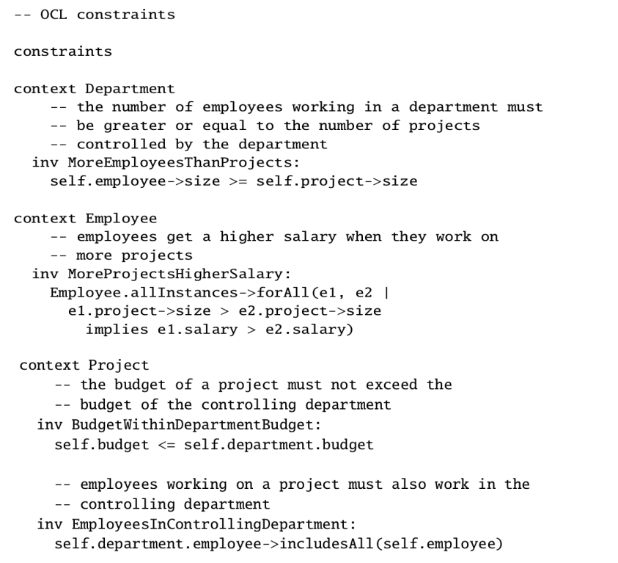
Adding Constrains
The number of employees working in a department must be greater or equal to the no. of projects controlled by the department
The budget of a project must not exceed the budget of the controlling department
Employees working on a project must also work in the controlling department
Employees get a higher salary when they work on more projects

Slide 114
Example 3

Slide 115
Student
Module
0..*
1..*
name: String
taken_by
takes
code: String
credit: Integer
0..*
submitted_by
for_module
set_work
1..*
Assessment
submits
1..*
weight: Integer
Exam
Coursework
hours: Integer
date: String

Slide 116
Constraints
Modules must have more than seven students registered
The assessments for a module must total to 100
Students must register for 120 credits each year
Students must take at least 90 credits of CS modules each year
All modules must have at least one assessment worth over 50
Students can only have assessments for modules which they are taking

Slide 117
Constraint 1
Student
Module
0..*
1..*
name: String
taken_by
takes
code: String
credit: Integer
0..*
submitted_by
for_module
Modules must have more than seven students registered
context Module
inv: taken_by->size > 7
set_work
1..*
Assessment
submits
1..*
weight: Integer
Exam
Coursework
hours: Integer
date: String

Slide 118
Constraint 2
Student
Module
0..*
1..*
name: String
taken_by
takes
code: String
credit: Integer
0..*
submitted_by
for_module
set_work
1..*
The assessments for a module must total to 100%
context Module
inv: set_work.weight->sum( ) = 100
Assessment
submits
1..*
weight: Integer
Exam
Coursework
hours: Integer
date: String

Slide 119
Constraint 3
Student
Module
0..*
1..*
name: String
taken_by
takes
code: String
credit: Integer
0..*
submitted_by
for_module
set_work
1..*
Students must register for 120 credits each year
context Student
inv: takes.credit->sum( ) = 120
Assessment
submits
1..*
weight: Integer
Exam
Coursework
hours: Integer
date: String

Slide 120
Constraint 4
Student
Module
0..*
1..*
taken_by
takes
name: String
code: String
credit: Integer
0..*
submitted_by
for_module
set_work
1..*
Students must take at least
90 credits of CS modules each year
context Student inv:
takes->select(code.substring(1,2) =
‘CS’).credit->sum() >= 90
Assessment
submits
1..*
weight: Integer
Exam
Coursework
hours: Integer
date: String

Slide 121
Constraint 5
Student
Module
0..*
1..*
name: String
taken_by
takes
code: String
credit: Integer
0..*
submitted_by
for_module
set_work
1..*
All modules must have at least one assessment worth over 50%
context Module
inv: set_work->exists(weight > 50)
Assessment
submits
1..*
weight: Integer
Exam
Coursework
hours: Integer
date: String

Slide 122
Constraint 6
Student
Module
0..*
1..*
taken_by
takes
code: String
credit: Integer
name: String
0..*
submitted_by
for_module
set_work
1..*
Students can only have assessments for modules which they are taking
context Student
inv: takes->includesAll(submits.for_module)
Assessment
submits
1..*
weight: Integer
Exam
Coursework
hours: Integer
date: String

Slide 123
Thank you!

Slide 124
Alloy Modelling Language

Slide 125
Alloy
Alloy is a formal modeling language aimed at expressing structural and behavioral properties of software systems
Alloy has formal syntax and semantics
There is also a visual representation (similar to UML class diagrams and entity-relationship diagrams) but the visual representation does not have the expressiveness of the whole language
Alloy has a verification tool called Alloy Analyzer which can be used to automatically analyze properties of Alloy models

Slide 126
Alloy
Formal modeling of entities and associations, using sets and relations
In Alloy, everything is a set and those sets are built from atoms and relations
An atom is a primitive entity that is indivisible, immutable, uninterpreted (it does not have any built-in property)
A relation is a structure that relates atoms.
It is a set of tuples, each tuple being a sequence of atoms
Modeling of invariants/constraints on the relationships
Analyzing the model, and identifying whether
it is under-constrained (i.e., allows erroneous relationships),
or over-constrained (i.e., disallows required relationships)

Slide 127
Signatures
Entities are represented using Signatures in Alloy
Describe classes of entities we want to reason about
For Example, for a school management system entities will be: Student, Teacher, Subject, etc.
Syntax:
sig Student{}
sig Teacher{}
sig Subject{}

Slide 128




Signatures
Alloy can generate models that have elements of each signature, called atoms. Following are some of the models generated by Alloy
Model 1 – Student= {Student0, Student1}, Teacher={Teacher0, Teacher1}, Subject={Subject}
Model 2 – Student= {Student}, Teacher={Teacher0, Teacher1, Teacher2}, Subject={Subject}
Model 3 – Student= {Student0, Student1}, Teacher={}, Subject={}
Model 4 – Student= {Student}, Teacher={Teacher}, Subject={}
Atom

Slide 129
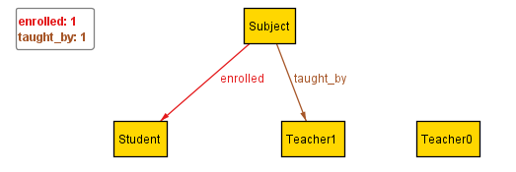
Relations - Fields
Usually, we care about the relationships between the parts of our systems.
We don’t just care that there are students, teachers and subjects, we care which students are enrolled in what subjects, which subject is taught by whom, etc.
We do this by adding relations inside of the signature body. These are called Fields.
The body of a signature is a list of relations, which show how the signatures are connected to each other.
Relations are separated by a comma. The list can also start and end with a comma. Relations do not have to be on separate lines, as long as they are separated by commas.
Continuing the example:
sig Student{}
sig Teacher{}
sig Subject{
taught_by: Teacher,
enrolled: Student,
}
One of the models generated by Alloy
Subject={Subject}, Student={Student}, Teacher={Teacher1, Teacher2}
taught_by = {(Subject, Teacher1)}, enrolled={(Subject, Student)}
Atom
Tuple

Slide 130
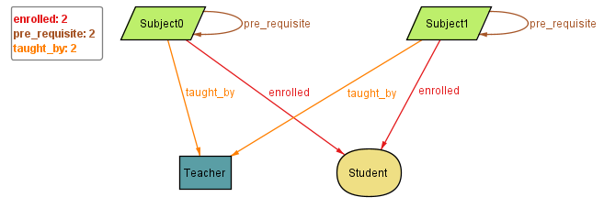
Relation - Fields
Relations can refer to the same signature.
For Example:
sig Student{}
sig Teacher{}
sig Subject{
taught_by: Teacher,
enrolled: Student,
pre_requisite: Subject
}
One of the models generated:
Subject={Subject0, Subject1}, Student={Student}, Teacher={Teacher}
taught_by = {(Subject0, Teacher), (Subject1,Teacher)}, enrolled={(Subject0, Student), (Subject1, Student)}, pre_requisite={(Subject0,Subject0), (Subject1,Subject1)}
Alloy can generate models where a relation points from an atom to itself, aka a “self-loop”.
For this reason we often want to add constraints to our model, such as Facts or Predicates.

Slide 131
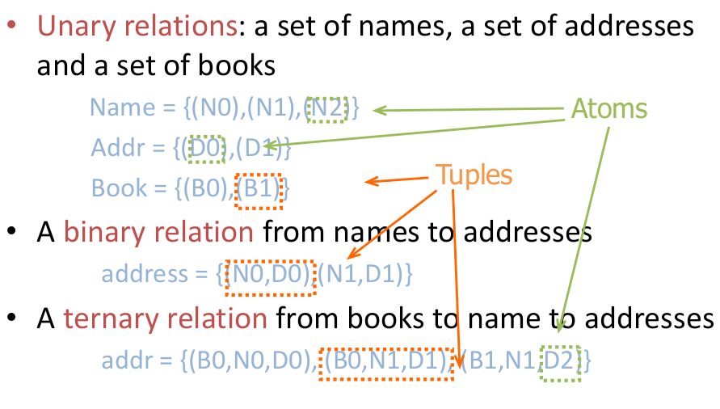
Atoms & Relations
Size of a relation: the number of tuples in the relation
Arity of a relation: the number of atoms in each tuple of the relation
Relations with arity 1, 2, and 3 are said to be unary, binary, and ternary relations respectively
Examples.
relation of arity 1 and size 1
myName = {(N0)}
relation of arity 2 and size 3
address = {(N0,D0),(N1,D1),(N2,D1))

Slide 132
Field Expressions
A field can be a simple expression over other signatures.
sig Resource {
permissions: (User + Group)
}
In addition to full signatures, the expression may contain this, which refers to the specific atom itself.
sig Node {
-- no self loops
, edges: Node – this
}
A dependent field is one where the expression depends on the values of other fields in the atom. The dependencies must be fields defined either in the signature or its supertype.
sig Item {}
sig Person {
, favorite: Item
, second: Item - favorite
}

Slide 133
Continuing Academia Example
Removing Self loop
sig Student{}
sig Teacher{}
sig Subject{
taught_by: Teacher,
enrolled: Student,
pre_requisite: Subject - this
}

Slide 134
Multi-relations
Signatures can have multi-relations as fields:
sig Door {}
sig Card {}
sig Person {
access: Card -> Door
}
In this case access is a ternary relationship, where each element of access is a relation of form
Person -> Card -> Door.
access = {(Person0,Card1,Door1), (Person1,Card0, Door0)}

Slide 135
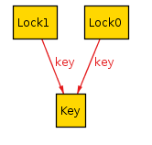
Multiplicity - one
Each relation has a multiplicity, which represents how many atoms it can include. If you do not include a multiplicity, it’s assumed to be one.
one
The default.
r: one A states that there is exactly one A in the set.
sig Key {}
sig Lock { key: one Key }
This says that every lock has exactly one Key. This does not guarantee a 1-1 correspondence! Two locks can share the same key.
If no multiplicity is listed, Alloy assumes to be one. So, the above relation can also be written as key: Key.

Slide 136
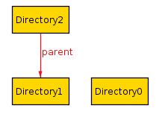
Multiplicity - lone
lone
r: lone A
states that either there is one A in the set, or that the set is empty. You can also think of it as “optional”.
Example:
sig Directory {
parent: lone Directory
}
This says that every directory either has one parent, or it does not have a parent (it’s a root directory).

Slide 137
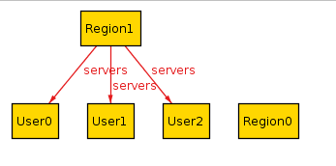
Multiplicity - set
set
r: set A
states that there can be any number of A in the relation.
Example:
sig User {}
sig Region {
servers: set User
}

Slide 138
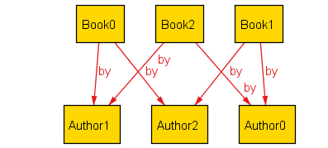
Multiplicity - some
some
r: some A
states that there is at least one A in the relation.
Example:
sig Author {}
sig Book {
by: some Author
}

Slide 139
Multiplicity - disj
disj
disj can be prepended to any multiplicity to guarantee that it will be disjoint among all atoms. If we write
sig Lock {}
sig Key {
lock: disj one Lock
}
Then every key will correspond to a different lock. If we instead write
sig Lock {}
sig Key {
locks: disj some Lock
}
Then every key will correspond to one or more locks, but no two keys will share a lock.

Slide 140
Signature Multiplicity
In addition to having multiplicity relationships, we can put multiplicities on the signatures themselves.
one sig Foo {}
some sig Bar {}
//etc
By default, signatures have multiplicity set, and there may be zero or more in the model.
By making the signature one, every model will have exactly one atom of that signature.
By writing some, there will be at least one.
By writing lone, there will be zero or one.

Slide 141
Multiplicity in Multi-relations
Multirelations have a special kind of multiplicity:
r: A m -> n B
This says that each member of A is mapped to n elements of B, and m elements of A map to each element of B. If not specified, the multiplicities are assumed to be set.

Slide 142
r: A m -> n B
m | n | Meaning
set | set | No restrictions
set | some | Each A used at least once
set | one | Each A is mapped to exactly one B (total function)
set | lone | Each A is mapped to at most one B (partial function)
some | set | Each B mapped to at least once
some | some | Every A mapped from and every B mapped to
some | one | Each A used exactly once, each B used at least once
some | lone | Each A used at most once, each B used at least once
one | set | Each B used exactly once, no other restrictions (one A can map to two B atoms)
one | some | Each B used exactly once, each A used at least once
one | one | Only satisfiable if #A = #B, bijection
one | lone | At most #A arrows, exactly #B arrows, each A used at most once
lone | set | Each B used at most once
lone | some | Each A used at least once and each B used at most once
lone | one | Each A used exactly once, each B used at most once
lone | lone | Each A used at most once, each B used at most once

Slide 143
Continuing Academia Example
Adding multiplicity constraints
module tour/schoolmgmt
sig Student{}
some sig Teacher{}
some sig Subject{
taught_by: one Teacher,
enrolled: some Student,
pre_requisite: set Subject- this
}
pred show() {}
run show for 3 but 2 Teacher

Slide 144
Subtypes
We can make some signatures subtypes of other signatures.
In
Creates inclusive subsets
Writing sig Child in Parent creates Child set a subset of Parent.
Example:
sig Machine {}
sig Broken in Machine {}
sig Online in Machine {}
In this case, Broken and online are subsets of Machines.
Any Machine can be Broken, Online, both, or neither.

Slide 145
Subtypes
extends
Creates disjoint subsets
Example:
sig Machine {}
sig Client extends Machine {}
sig Server extends Machine {}
In this case, any Machine can be a Server, a Client, or neither, but not both.

Slide 146
Abstract supertype
abstract
If you make a signature abstract, then all atoms of the signature will belong to extensions.
There will be no atoms that are just the supertype and not any of the subtypes.
Example
abstract sig Machine {}
sig Broken in Machine {}
sig Server extends Machine {}
sig Client extends Machine {}
Here any machine must be either a Server or a Client. They still may or may not be Broken.

Slide 147
